Slide 1
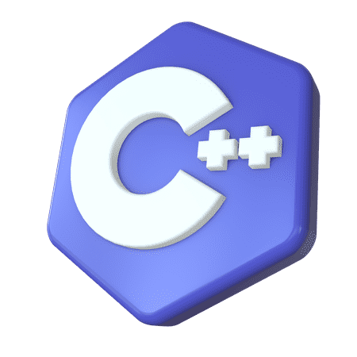

INTRODUCTION TO C, C++ & COMPETETIVE PROGRAMMING
“Basics, Syntax, and the Stepping into the World of Coding Competitions”

Slide 2



INTRODUCTION TO C, C++ & COMPETETIVE PROGRAMMING
“Basics, Syntax, and the Stepping into the World of Coding Competitions”

Slide 3
SUBMITTED BY
INTRODUCTION TO C, C++ & COMPETETIVE PROGRAMMING
“Basics, Syntax, and the Stepping into the World of Coding Competitions”

Slide 4
SUBMITTED BY
NAME : RIFAT AHSAN RIF
SID : 00724205101042
PROGRAM : CSE
SEMESTER : FALL 24

Slide 5
SUBMITTED BY
NAME : ARAF HOSSAIN
SID : 00724205101058
PROGRAM : CSE
SEMESTER : FALL 24

Slide 6
SUBMITTED BY
NAME : NAFIZ KHAN
SID : 00724205101064
PROGRAM : CSE
SEMESTER : FALL 24
MS. NUSRAT JAHAN
LECTURER GRADE-I, AUST
MS. TASNUVA BINTE RAHMAN
LECTURER GRADE-II, AUST

Slide 7

SUBMITTED BY
SUBMITTED TO
MS. NUSRAT JAHAN
LECTURER GRADE-I, AUST
MS. TASNUVA BINTE RAHMAN
LECTURER GRADE-II, AUST

Slide 8


ANALYTICAL OVERVIEW what we’ll know?
SUBMITTED TO
MS. NUSRAT JAHAN
LECTURER GRADE-I, AUST
MS. TASNUVA BINTE RAHMAN
LECTURER GRADE-II, AUST
Chronicle of C
C Language
Drawbacks / Limitations of C
C++ Language
Contrast Between C & C++
Competitive Programming

Slide 9
ANALYTICAL OVERVIEW what we’ll learn?
CHRONICLES OF C & C++
The Begin of Story
Chronicle of C & C++
C Language
Drawbacks / Limitations of C
C++ Language
Contrast Between C & C++
Competitive Programming
Dennis MacAlistair Ritchie
(September 9, 1941 – c. October 12, 2011)
Known for ALTRAN, B, BCPL, C, Multics, Unix
Created by Dennis Ritchie at Bell Labs, 1969, 1972
UNIX rewritten in C, 1973K&R C published (The C Programming Language), 1978
Standardized as ANSI C (C89) and ISO C (C90), 1989, 1990
Successive updates C99, C11, C17, C23 in 1999, 2011, 2018, 2023

Slide 10
CHRONICLES OF C
The Begin of Story
Created by Dennis Ritchie at Bell Labs, 1969, 1972
UNIX rewritten in C, 1973
K&R C published (The C Programming Language), 1978
Standardized as ANSI C (C89) and ISO C (C90), 1989, 1990
Successive updates C99, C11, C17, C23 in 1999, 2011, 2018, 2023
Dennis MacAlistair Ritchie
(September 9, 1941 – c. October 12, 2011)
Known for ALTRAN, B, BCPL, C, Multics, Unix
[1]

Slide 11
C LANGUAGE
Key Features
General-purpose language, applicable across system and application development
Structured and procedural, promotes modular and maintainable code
High performance and efficiency, close to hardware execution speed
Portable, easily compiled and executed on multiple platforms
[2]

Slide 12

C LANGUAGE
(Continue)
Common Syntax in C
Key Features
Basic
Basic
#include <stdio.h>
int main()
{
int x = 10; // Variable
int sum = 5 + 5;
printf("Hello, World!\n");
// Statement
return 0; //Exit Status
}
#include <stdio.h>
int main() {
int i;
// For loop
for(i = 0; i < 5; i++){
printf("%d ", i);
}
printf("\n\n");
return 0;
}
General-purpose language, applicable across system and application development
Structured and procedural, promotes modular and maintainable code
High performance and efficiency, close to hardware execution speed
Portable, easily compiled and executed on multiple platforms

Slide 13
DRAWBACKS OF C
Understanding C’s Weak Points
Manual memory management
Limited standard library compared to modern languages
No type safety for certain operations
Harder to write large-scale programs due to lack of modularity enforcement
Platform-dependent behavior for some functions and data types
No Object-Oriented Programming
Lack of Built in Error Handling
Pointer Error
No Support for Moder Feature
Lack of Namespace Support

Slide 14
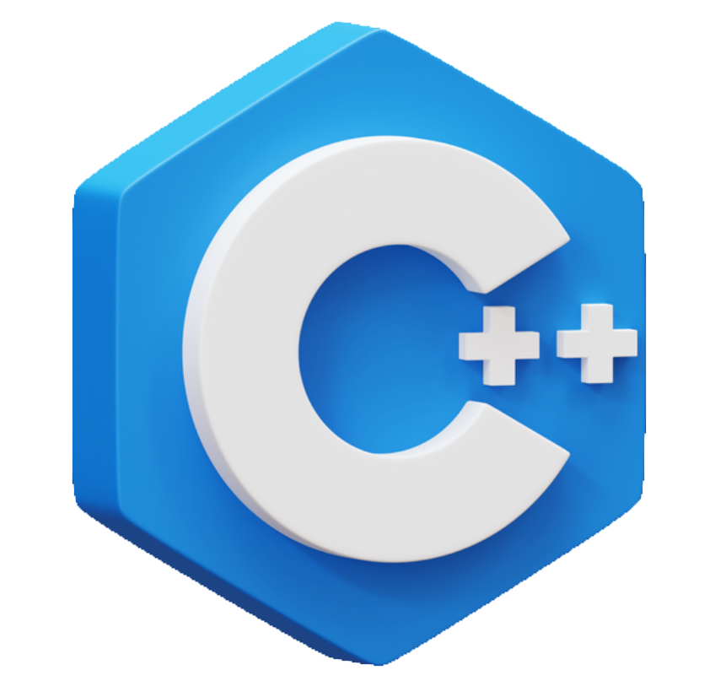
DRAWBACKS OF C
Understanding C’s Weak Points
No Object-Oriented Programming
Lack of Built in Error Handling
Pointer Error
No Support for Moder Feature
Lack of Namespace Support
Manual memory management
Limited standard library compared to modern languages
No type safety for certain operations
Harder to write large-scale programs due to lack of modularity enforcement
[3]

Slide 15
Manual memory management
Limited standard library compared to modern languages
No type safety for certain operations
Harder to write large-scale programs due to lack of modularity enforcement
DRAWBACKS OF C
Understanding C’s Weak Points

Slide 16
C++ Language
1
1
Why Prefer C++?
What is C++?
2
3
C++ is one of the world's most popular programming languages.
C++ can be found in today's operating systems, Graphical User Interfaces, and embedded systems.
C++ is an object-oriented programming language which gives a clear structure to programs and allows code to be reused, lowering development costs.
C++ is a cross-platform language that can be used to create high-performance applications.
C++ was developed by Bjarne Stroustrup, as an extension to the C language.
The language was updated 5 major times in 2011, 2014, 2017, 2020, and 2023 to C++11, C++14, C++17, C++20, and C++23.
4
5
[4]
6

Slide 17
C++ Language
1
(Continue)
Why Prefer C++?
2
2
3
C++ is one of the world's most popular programming languages.
C++ can be found in today's operating systems, Graphical User Interfaces, and embedded systems.
C++ is an object-oriented programming language which gives a clear structure to programs and allows code to be reused, lowering development costs.
C++ is a cross-platform language that can be used to create high-performance applications.
C++ was developed by Bjarne Stroustrup, as an extension to the C language.
The language was updated 5 major times in 2011, 2014, 2017, 2020, and 2023 to C++11, C++14, C++17, C++20, and C++23.
C++ is portable and can be used to develop applications that can be adapted to multiple platforms.
C++ is fun and easy to learn!
As C++ is close to C, C# and Java, it makes it easy for programmers to switch to C++ or vice versa.
4
5
6

Slide 18
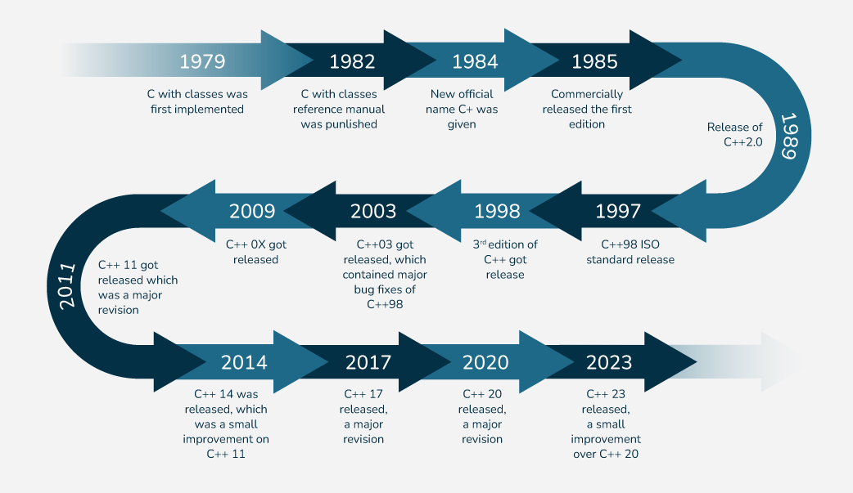
C++ Language
1
(Continue)
History of C++
Why Prefer C++?
2
2
3
C++ is one of the world's most popular programming languages.
C++ can be found in today's operating systems, Graphical User Interfaces, and embedded systems.
C++ is an object-oriented programming language which gives a clear structure to programs and allows code to be reused, lowering development costs.
C++ is portable and can be used to develop applications that can be adapted to multiple platforms.
C++ is fun and easy to learn!
As C++ is close to C, C# and Java, it makes it easy for programmers to switch to C++ or vice versa.
4
5
6

Slide 19
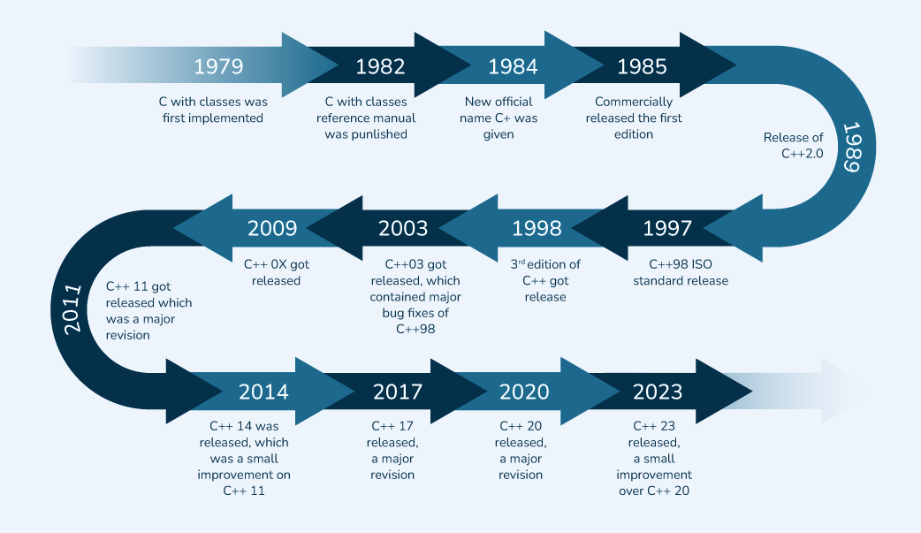
C++ Language
1
(Continue)
C vs C++: What Sets Them Apart
History of C++
2
Why Prefer C++?
ASPECT | C | C++
Standard I/O | Uses stdio.h with scanf() and printf() | Uses iostream with cin and cout
Extension | File extension is “.c” | File extension is “.cpp”, “.c++”
Namespaces | Features are not present inside C | Used by C++, which avoid name collisions
Overloading | Function and operator overloading is not supported in C | Function and operator overloading is supported by C++
ASPECT | C | C++
OOPs Support | Doesn’t Support OOP since it lacks polymorphism & inheritance | Supports OOP as it provides polymorphism & inheritance
Subset / Superset | A subset of C++ | A superset of C
Keywords | C99 : 37, C11 : 44, C23: 59 | C++11: 73, C++17: 73, C++20: 81
Encapsulation | Data and Functions are separated | Data and functions are combined into objects
3
3
C++ is portable and can be used to develop applications that can be adapted to multiple platforms.
C++ is fun and easy to learn!
As C++ is close to C, C# and Java, it makes it easy for programmers to switch to C++ or vice versa.
4
5
6
[5]
Fig : Timeline of C++ Versions from 1979 to 2023

Slide 20
C++ Language
1
(Continue)
C vs C++: What Sets Them Apart
2
History of C++
ASPECT | C | C++
Standard I/O | Uses stdio.h with scanf() and printf() | Uses iostream with cin and cout
Extension | File extension is “.c” | File extension is “.cpp”, “.c++”
Namespaces | Features are not present inside C | Used by C++, which avoid name collisions
Overloading | Function and operator overloading is not supported in C | Function and operator overloading is supported by C++
ASPECT | C | C++
OOPs Support | Doesn’t Support OOP since it lacks polymorphism & inheritance | Supports OOP as it provides polymorphism & inheritance
Subset / Superset | A subset of C++ | A superset of C
Keywords | C99 : 37, C11 : 44, C23: 59 | C++11: 73, C++17: 73, C++20: 81
Encapsulation | Data and Functions are separated | Data and functions are combined into objects
3
4
4
5
6
Table 1 : Contrast between C & C++
[6]

Slide 21
C++ Language
1
(Continue)
Fundamental Syntax of C++
C vs C++: What Sets Them Apart
2
Variables
ASPECT | C | C++
Standard I/O | Uses stdio.h with scanf() and printf() | Uses iostream with cin and cout
Extension | File extension is “.c” | File extension is “.cpp”, “.c++”
Namespaces | Features are not present inside C | Used by C++, which avoid name collisions
Overloading | Function and operator overloading is not supported in C | Function and operator overloading is supported by C++
ASPECT | C | C++
OOPs Support | Doesn’t Support OOP since it lacks polymorphism & inheritance | Supports OOP as it provides polymorphism & inheritance
Subset / Superset | A subset of C++ | A superset of C
Keywords | C99 : 37, C11 : 44, C23: 59 | C++11: 73, C++17: 73, C++20: 81
Encapsulation | Data and Functions are separated | Data and functions are combined into objects
#include <iostream>
int main()
{
std::cout << "Hello QuickRef\n";
return 0;
}
int number = 5; // Integer
float f = 0.95; // Floating number
double PI = 3.14159; // Floating number
char yes = 'Y'; // Character
std::string s = "ME"; // String (text)
bool isRight = true; // Boolean
----------------------------------------
// Constants
const float RATE = 0.8;
int age {25}; // Since C++11
std::cout << age; // Print 25
Hello
3
4
4
Input/Output
int num;
std::cout << "Type a number: ";
std::cin >> num;
std::cout << "You entered " << num;
5
6
Table 2 : Contrast between C & C++

Slide 22
C++ Language
1
(Continue)
Fundamental Syntax of C++
2
C vs C++: What Sets Them Apart
if Clause
Ternary Operator
Variables
ASPECT | C | C++
Standard I/O | Uses stdio.h with scanf() and printf() | Uses iostream with cin and cout
Extension | File extension is “.c” | File extension is “.cpp”, “.c++”
Namespaces | Features are not present inside C | Used by C++, which avoid name collisions
Overloading | Function and operator overloading is not supported in C | Function and operator overloading is supported by C++
ASPECT | C | C++
OOPs Support | Doesn’t Support OOP since it lacks polymorphism & inheritance | Supports OOP as it provides polymorphism & inheritance
Subset / Superset | A subset of C++ | A superset of C
Keywords | C99 : 37, C11 : 44, C23: 59 | C++11: 73, C++17: 73, C++20: 81
Encapsulation | Data and Functions are separated | Data and functions are combined into objects
if (a == 10) {
// do something
}
int number = 16;
if (number % 2 == 0)
std::cout << "even";
else
std::cout << "odd";
// Outputs: even
┌── True ──┐
Result = Condition ? Exp1 : Exp2;
└───── False ─────┘
int x = 3, y = 5, max;
max = (x > y) ? x : y;
----------------------------------------
int x = 3, y = 5, max;
if (x > y)
max = x;
else
max = y;
// Outputs: 5
#include <iostream>
int main()
{
std::cout << "Hello QuickRef\n";
return 0;
}
int number = 5; // Integer
float f = 0.95; // Floating number
double PI = 3.14159; // Floating number
char yes = 'Y'; // Character
std::string s = "ME"; // String (text)
bool isRight = true; // Boolean
----------------------------------------
// Constants
const float RATE = 0.8;
int age {25}; // Since C++11
std::cout << age; // Print 25
Hello
3
4
Input/Output
int num;
std::cout << "Type a number: ";
std::cin >> num;
std::cout << "You entered " << num;
5
5
6
[7]

Slide 23
C++ Language
1
(Continue)
Fundamental Syntax of C++
2
Loops
Ranged Based
if Clause
Ternary Operator
Variables
for (int i = 1; i <= 5; i++) {
std::cout << i << "\n";
}
int i = 1;
while (i < 6) {
std::cout << i++;
}
int i = 1;
do {
std::cout << i++;
} while (i <= 5);
for (int n : {1, 2, 3, 4, 5}) {
std::cout << n << " ";
}
// Outputs: 1 2 3 4 5
------------------------------------
std::string hello = "QuickRef.ME";
for (char c: hello)
{
std::cout << c << " ";
}
// Outputs: Q u i c k R e f . M E
if (a == 10) {
// do something
}
int number = 16;
if (number % 2 == 0)
std::cout << "even";
else
std::cout << "odd";
// Outputs: even
┌── True ──┐
Result = Condition ? Exp1 : Exp2;
└───── False ─────┘
int x = 3, y = 5, max;
max = (x > y) ? x : y;
----------------------------------------
int x = 3, y = 5, max;
if (x > y)
max = x;
else
max = y;
// Outputs: 5
#include <iostream>
int main()
{
std::cout << "Hello QuickRef\n";
return 0;
}
int number = 5; // Integer
float f = 0.95; // Floating number
double PI = 3.14159; // Floating number
char yes = 'Y'; // Character
std::string s = "ME"; // String (text)
bool isRight = true; // Boolean
----------------------------------------
// Constants
const float RATE = 0.8;
int age {25}; // Since C++11
std::cout << age; // Print 25
Hello
3
4
Input/Output
5
int num;
std::cout << "Type a number: ";
std::cin >> num;
std::cout << "You entered " << num;
5
6

Slide 24
C++ Language
1
(Continue)
Fundamental Syntax of C++
2
Arrays
Vectors
Loops
Ranged Based
if Clause
Ternary Operator
std::array<int, 3> marks;
// Definition
marks[0] = 92;
marks[1] = 97;
marks[2] = 98;
// Define and initialize
std::array<int, 3> = {92, 97};
// With empty members
std::array<int, 3> marks = {92, 97};
std::vector<int> marks(3);
//vector of size 3, initialized to 0
marks[0] = 92;
marks[1] = 97;
marks[2] = 98;
// Define and initialize
std::vector<int> marks{92, 97};
//Appending
std::vector<int> marks;
marks.push_back(92);
marks.push_back(97);
for (int i = 1; i <= 5; i++) {
std::cout << i << "\n";
}
int i = 1;
while (i < 6) {
std::cout << i++;
}
int i = 1;
do {
std::cout << i++;
} while (i <= 5);
for (int n : {1, 2, 3, 4, 5}) {
std::cout << n << " ";
}
// Outputs: 1 2 3 4 5
------------------------------------
std::string hello = "QuickRef.ME";
for (char c: hello)
{
std::cout << c << " ";
}
// Outputs: Q u i c k R e f . M E
if (a == 10) {
// do something
}
int number = 16;
if (number % 2 == 0)
std::cout << "even";
else
std::cout << "odd";
// Outputs: even
┌── True ──┐
Result = Condition ? Exp1 : Exp2;
└───── False ─────┘
int x = 3, y = 5, max;
max = (x > y) ? x : y;
----------------------------------------
int x = 3, y = 5, max;
if (x > y)
max = x;
else
max = y;
// Outputs: 5
3
4
5
5
6

Slide 25
C++ Language
1
(Continue)
Benefits?
Fundamental Syntax of C++
2
Arrays
Vectors
Loops
Ranged Based
std::array<int, 3> marks;
// Definition
marks[0] = 92;
marks[1] = 97;
marks[2] = 98;
// Define and initialize
std::array<int, 3> = {92, 97};
// With empty members
std::array<int, 3> marks = {92, 97};
std::vector<int> marks(3);
//vector of size 3, initialized to 0
marks[0] = 92;
marks[1] = 97;
marks[2] = 98;
// Define and initialize
std::vector<int> marks{92, 97};
//Appending
std::vector<int> marks;
marks.push_back(92);
marks.push_back(97);
for (int i = 1; i <= 5; i++) {
std::cout << i << "\n";
}
int i = 1;
while (i < 6) {
std::cout << i++;
}
int i = 1;
do {
std::cout << i++;
} while (i <= 5);
for (int n : {1, 2, 3, 4, 5}) {
std::cout << n << " ";
}
// Outputs: 1 2 3 4 5
------------------------------------
std::string hello = "QuickRef.ME";
for (char c: hello)
{
std::cout << c << " ";
}
// Outputs: Q u i c k R e f . M E
3
C++ program is useful for low-level programming language
Has a large and mature ecosystem of libraries
Has less time complexity
Could also be a problem-oriented language that's much easier to use than the other low-level languages like binary coding.
4
5
5
6

Slide 26

C++ Language
1
(Continue)
Benefits?
2
Fundamental Syntax of C++
Arrays
Vectors
std::array<int, 3> marks;
// Definition
marks[0] = 92;
marks[1] = 97;
marks[2] = 98;
// Define and initialize
std::array<int, 3> = {92, 97};
// With empty members
std::array<int, 3> marks = {92, 97};
std::vector<int> marks(3);
//vector of size 3, initialized to 0
marks[0] = 92;
marks[1] = 97;
marks[2] = 98;
// Define and initialize
std::vector<int> marks{92, 97};
//Appending
std::vector<int> marks;
marks.push_back(92);
marks.push_back(97);
3
C++ program is useful for low-level programming language
Has a large and mature ecosystem of libraries
Has less time complexity
Could also be a problem-oriented language that's much easier to use than the other low-level languages like binary coding.
4
5
6
6

Slide 27
C++ Language
1
(Continue)
Benefits?
2
3
C++ program is useful for low-level programming language
Has a large and mature ecosystem of libraries
Has less time complexity
Could also be a problem-oriented language that's much easier to use than the other low-level languages like binary coding.
4
5
6
6

Slide 28
COMPETITIVE PROGRAMMING
What is Competitive Programming?
Solving algorithmic problems under time constraints
Competitions like ACM ICPC, Google Code Jam, Meta Hacker Cup
Tests coding skills, logic, and problem-solving efficiency
[8]

Slide 29

COMPETITIVE PROGRAMMING
(Continue)
Why should anyone participate?
Enhances problem-solving & logical thinking
Improves coding efficiency
Helps in technical interviews & career growth
Builds competitive spirit and global ranking opportunities

Slide 30




COMPETITIVE PROGRAMMING
(Continue)
How to get started?
Learn a programming language thoroughly
Study basic algorithms (e.g sorting, searching)
Practice regularly on online platforms
Join communities and discuss solutions

Slide 31
COMPETITIVE PROGRAMMING
(Continue)
Where to go?
[9]

Slide 32
COMPETITIVE PROGRAMMING
(Continue)
Where to go?
Beginner-friendly platform with guided learning paths.
Covers a wide range of domains (algorithms, AI, SQL, etc.).
Useful for practicing coding interviews and company hiring tests.
Hackerrank

Slide 33
COMPETITIVE PROGRAMMING
(Continue)
Where to go?
Beginner-friendly platform with guided learning paths.
Covers a wide range of domains (algorithms, AI, SQL, etc.).
Useful for practicing coding interviews and company hiring tests.
Hackerrank

Slide 34
COMPETITIVE PROGRAMMING
(Continue)
Where to go?
One of the most popular competitive programming sites worldwide.
Frequent contests with diverse problem difficulty levels.
Strong community & editorials for deep learning.
Codeforces

Slide 35
COMPETITIVE PROGRAMMING
(Continue)
Where to go?
One of the most popular competitive programming sites worldwide.
Frequent contests with diverse problem difficulty levels.
Strong community & editorials for deep learning.
Codeforces

Slide 36
COMPETITIVE PROGRAMMING
(Continue)
Where to go?
Focused on interview preparation with real-world coding challenges.
Well-structured problems categorized by topics & companies.
Premium contests (weekly/biweekly) simulate interview-style pressure.
Leetcode

Slide 37
COMPETITIVE PROGRAMMING
(Continue)
Where to go?
Focused on interview preparation with real-world coding challenges.
Well-structured problems categorized by topics & companies.
Premium contests (weekly/biweekly) simulate interview-style pressure.
Leetcode

Slide 38
COMPETITIVE PROGRAMMING
(Continue)
Where to go?
Japanese platform known for high-quality, well-crafted problems.
Regular contests with clear problem statements.
Great for gradually building problem-solving skills.
Atcoder

Slide 39
COMPETITIVE PROGRAMMING
(Continue)
Where to go?
Japanese platform known for high-quality, well-crafted problems.
Regular contests with clear problem statements.
Great for gradually building problem-solving skills.
Atcoder

Slide 40

COMPETITIVE PROGRAMMING
(Continue)
Where to go?
Japanese platform known for high-quality, well-crafted problems.
Regular contests with clear problem statements.
Great for gradually building problem-solving skills.
Atcoder
REFERENCES
[1] wikipedia.org
[2] copilot.ai
[3] chatgpt.ai
[4] grok.ai
[5] geekforgeek
[6] geekforgeek
[7] quickref.me
[8] google.com
[9] github copilot

Slide 41
ANY QUERIES?
(Continue)
Where to go?
Japanese platform known for high-quality, well-crafted problems.
Regular contests with clear problem statements.
Great for gradually building problem-solving skills.
Atcoder

Slide 42


THANK YOU!
(Continue)
Where to go?
Japanese platform known for high-quality, well-crafted problems.
Regular contests with clear problem statements.
Great for gradually building problem-solving skills.
Atcoder

Slide 43
THANK YOU!
(Continue)
Where to go?
Japanese platform known for high-quality, well-crafted problems.
Regular contests with clear problem statements.
Great for gradually building problem-solving skills.
Atcoder

